Slide 1
Basics of HTML & CSS
For Beginners

Slide 2
What is HTML?
You need you to find the meaning of it…google it..
https://www.w3schools.com/html/default.asp

Slide 3
What you will need to start :
Web browser:
Chrome
Or Safari
Or Firefox
Please do not use Internet explorer
Text Editor or IDE:
https://www.codecademy.com/article/what-is-an-ide
Sublime or Visual studio Code
https://code.visualstudio.com/

Slide 4
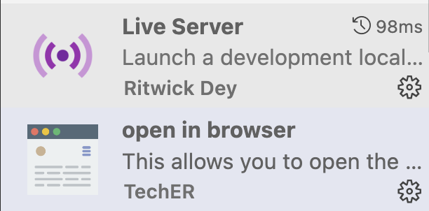
With visual studio code you have to install extensions:
Prettier

Slide 5
How to create a file with html:
Just create a folder and name a file anything ending with .html
By typing html then tab you can start your first html file.
This is the result of your first html file.

Slide 6
Mandatory tags in the HTML page (HTML, head, body)
<!DOCTYPE html>
<html lang="en">
<head>
<meta charset="UTF-8">
<meta http-equiv="X-UA-Compatible" content="IE=edge">
<meta name="viewport" content="width=device-width, initial-scale=1.0">
<title>Document</title>
</head>
<body>
</body>
</html>

Slide 7
How to specify the metadata in HTML5?
Specify in the <Head>
Specify in the <Body>
Specify in the <Script>
Specify in the <Footer>

Slide 8
The head contains the script for javascript or title which you can edit at this time. The head also contains the metadata information as seen here:
<head>
<meta charset="UTF-8">
<meta name="viewport" content="width=device-width, initial-scale=1.0">
<title>Document</title>
</head>

Slide 9
The body tags as we call it contains the information that we will display in the chrome web browser
<body>
</body>

Slide 10
What is the root element of html?
The <html> element is the root element and it defines the whole HTML document.
It has a start tag <html> and an end tag </html>.
Then, inside the <html> element there is a <body> element:

Slide 11
How would you write something in html as a heading?
The HTML element is everything from the start tag to the end tag:
<tagname>Content goes here...</tagname>
Examples of some HTML elements:
<h1>My First Heading</h1>
<p>My first paragraph.</p>

Slide 12
Heading in different fonts: How would we do it?
Heading 1
Heading 2
Heading 3
Heading 4
Heading 5
Heading 6
Try it Yourself »

Slide 13
Here it is :
<h1>Heading 1</h1>
<h2>Heading 2</h2>
<h3>Heading 3</h3>
<h4>Heading 4</h4>
<h5>Heading 5</h5>
<h6>Heading 6</h6>
According to Semantics what do we need?

Slide 14
Start tag | Element content | End tag
<h1> | My First Heading | </h1>
<p> | My first paragraph. | </p>
<br> | (Break or line break) | none

Slide 15
https://www.w3schools.com/css/tryit.asp?filename=trycss_intro
<style>
body{ Background-color: lightblue;
} h1{ Color: white;
Text-align: center;
}
</style>
Note: ** This is in the head ***

Slide 16
The href Attribute or hyperlink ( link to a website )
The <a> tag defines a hyperlink. The href attribute specifies the URL of the page the link goes to:
<a href="https://www.w3schools.com" >Visit W3Schools</a>
Do you know what is missing according to Accessibility in here?
Can you change the link to google, amazon, and other links:
https://www.w3schools.com/css/tryit.asp?filename=trycss_display_inline_list

Slide 17
The src Attribute for images
The <img> tag is used to embed an image in an HTML page. The src attribute specifies the path to the image to be displayed:
<img src="img_girl.jpg" width="500" height="600">
Do you know what is missing according to Accessibility in here?
https://www.w3schools.com/html/tryit.asp?filename=tryhtml_images_trulli

Slide 18
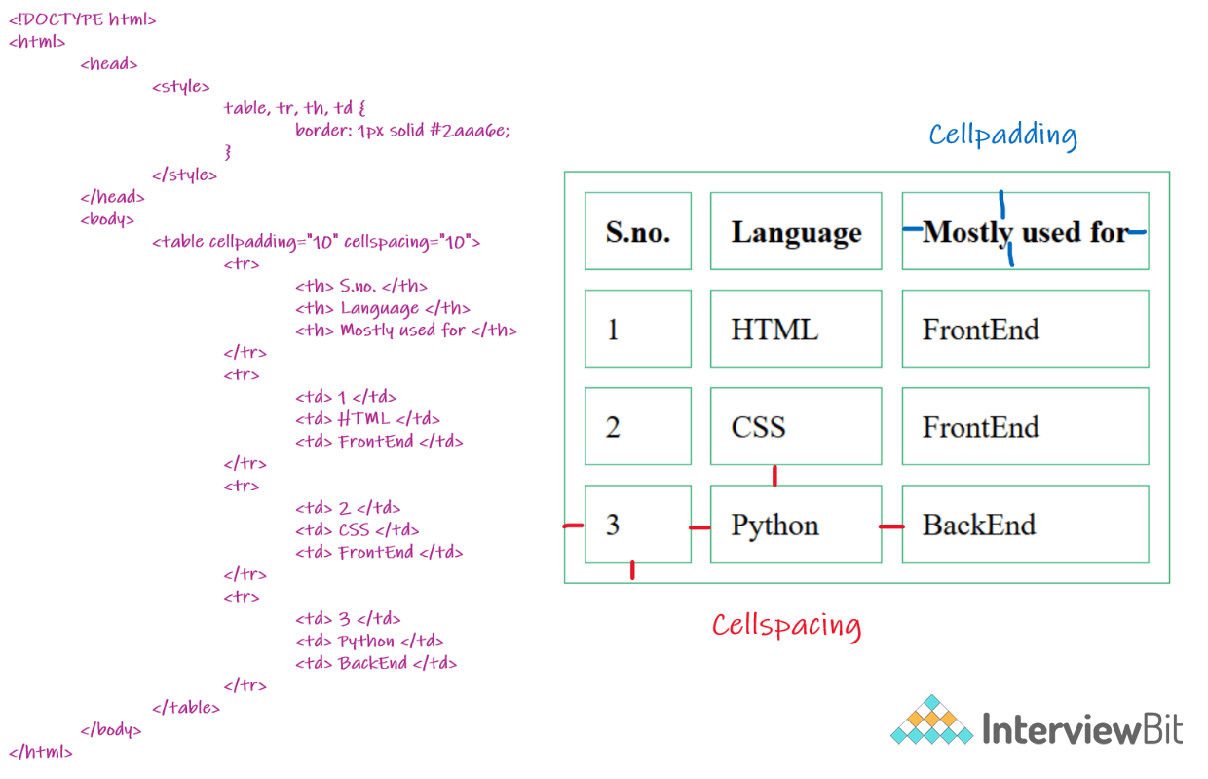
Working with row and column data using the table tags: https://www.w3schools.com/html/html_tables.asp

Slide 19
The void elements in HTML are as follows:
https://developer.mozilla.org/en-US/docs/Glossary/Void_element
<br>
<col>
<embed>
<hr>
<img>

Slide 20
What is CSS ?
CSS stands for Cascading Style Sheets
CSS describes how HTML elements are to be displayed on screen, paper, or in other media
CSS saves a lot of work. It can control the layout of multiple web pages all at once
External stylesheets are stored in CSS files

Slide 21
Class vs. Id in CSS
https://www.w3schools.com/css/css_selectors.asp
<h1 id="para1">Hello World!</h1>
<style>
#para1 {
text-align: center;
color: red;
}
</style>

Slide 22
Research in google HTML with Mosh youtube
https://www.youtube.com/watch?v=qz0aGYrrlhU&t=1136s

Slide 23
Three Ways to Insert CSS
External CSS
Internal CSS
Inline CSS

Slide 24
External:
Example
External styles are defined within the <link> element, inside the <head> section of an HTML page:
<!DOCTYPE html>
<html>
<head>
<link rel="stylesheet" href="mystyle.css">
</head>
<body>

Slide 25
Here is how the "mystyle.css" file looks:
body {
background-color: lightblue;
}
h1 {
color: navy;
margin-left: 20px;
}

Slide 26
2. Internal CSS
<head>
<style>
body {
background-color: linen;
}
h1 {
color: maroon;
margin-left: 40px;
}
</style>
</head>

Slide 27
3. Inline CSS
An inline style may be used to apply a unique style for a single element.
<body>
<h1 style="color:blue;text-align:center;">This is a heading</h1>
<p style="color:red;">This is a paragraph.</p>
</body>
Note: This is what the computer understands first. So, an inline style has the highest priority, and will override external and internal styles and browser defaults.
Tip: An inline style loses many of the advantages of a style sheet (by mixing content with presentation). Use this method sparingly.

Slide 28
HTML Tags Topics that we will learn:
Including external page links in a page using anchor tags and its properties • Working with row and column data using table tags
Hiding and unhiding elements using display property
image tag, p tag, ul and ol tags, li, nobr, hr, br etc
Layouts, forms, buttons
Input fields ( text box, radio button, checkbox, dropdown, text area etc) HTML5
List of Browsers support HTML5
Media tags (audio and video tags)
Graphics using Canvas tag
Drag and Drop features
Working on locations lat and long using Geolocation
Storing user preferences using LocalStorage.
After the Break….

Slide 29
HTML Links - The target Attribute
By default, the linked page will be displayed in the current browser window. To change this, you must specify another target for the link.
The target attribute specifies where to open the linked document.
The target attribute can have one of the following values:
_self - Default. Opens the document in the same window/tab as it was clicked
_blank - Opens the document in a new window or tab
_parent - Opens the document in the parent frame
_top - Opens the document in the full body of the window
Try this:
<a href="https://www.w3schools.com/" title=”w3schools” target="_blank">Visit W3Schools!</a>

Slide 30
2. Hiding and unhiding elements using display property
https://www.w3schools.com/css/css_display_visibility.asp
Hide an Element - display:none or visibility:hidden?

